Slide 1
Consumer Electronics
Audio Systems

Slide 2
Audio Systems
Audio amplifier,
Microphone,
Loudspeaker,
Public address systems,
What is DJ,
Audio as Data and Signal,
Digital Audio Processes Outlined,
Time Compression and Expansion.
Block diagram of home theatre & working
Consumer Electronics

Slide 3
Audio amplifier
Basic characteristics of sound signal:
level and loudness:
The amplitude of a sound wave determines its loudness or volume.
A larger amplitude means a louder sound, and a smaller amplitude means a softer sound.
The vibration of a source sets the amplitude of a wave. It transmits energy into the medium through its vibration.
More energetic vibration corresponds to larger amplitude. The molecules move back and forth more vigorously.
Consumer Electronics

Slide 4
Level and loudness …..
The loudness of a sound is also determined by the sensitivity of the ear. The human ear is more sensitive to some frequencies than to others.
The volume we receive thus depends on both the amplitude of a sound wave and whether its frequency lies in a region where the ear is more or less sensitive.
The loudness is a sensation of how strong a sound wave is at a place. It is always a relative term and is a dimensionless quantity.
Loudness is measured in decibel (dB). It is given as:
L = log(I), here ‘I’ is the intensity.
Consumer Electronics

Slide 5
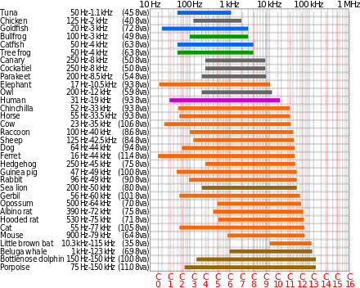
Hearing Range

Slide 6
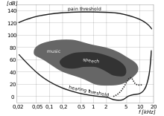
Human hearing area in frequency and intensity.

Slide 7
Pitch
Pitch is a characteristic of sound by which a correct note can be distinguished from a grave or a flat note.
We can identify a female and male voice without seeing them.
The term ‘pitch’ is often used in music.
Pitch depends upon the frequencies of the sound wave. A note has a higher pitch when the frequency is high and a note of low frequency has a low pitch.
Consumer Electronics

Slide 8
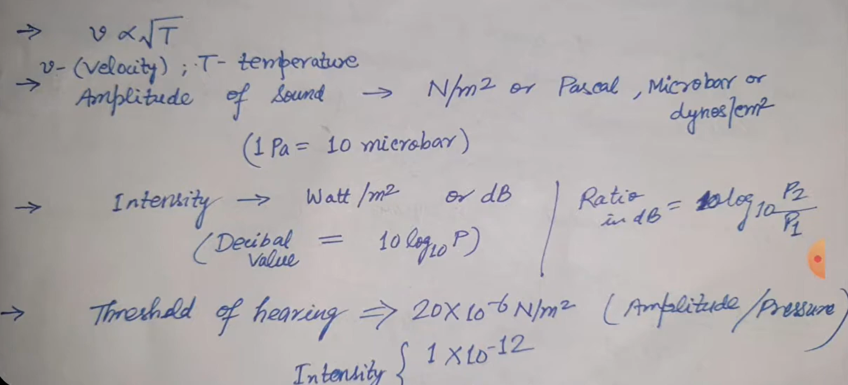

Slide 9
Frequency response:
The audio spectrum range spans from 20 Hz to 20,000 Hz and can be effectively broken down into different frequency bands, with each having a different impact on the total sound.
In signal processing and electronics, the frequency response of a system is the quantitative measure of the magnitude and phase of the output as a function of input frequency.
The frequency response is widely used in the design and analysis of systems, such as audio and control systems,
In an audio system, it may be used to minimize audible distortion by designing components (such as microphones, amplifiers and loudspeakers) so that the overall response is as flat (uniform) as possible across the system's bandwidth.
Consumer Electronics

Slide 10
Fidelity:
Fidelity is defined as the ability of an audio amplifier to reproduce all the sound frequencies faithfully i.e. amplify all of them equally.
Fidelity is the quality of faithfulness or loyalty.
Therefore the fidelity is dependent on the frequency response of the AF amplifier.
High fidelity (Hi-Fi) is essential in order reproduce a good quality music faithfully i.e. without introducing any distortion.
Usually the higher the decibel (Db), the better the quality of sound.
For this it is essential to have a flat frequency response over a wide range of audio frequency.
Consumer Electronics

Slide 11
Sensitivity of Human ear for Sound:
Sensitivity is defined as the ability to detect the weakest (low intensity) sound. The sensitivity of a human ear is as low as 0.1 pW/sq.m. (or 10 dB below the threshold of hearing).
The ear is not sensitive to the absolute value of sound intensity but it is sensitive to the ratios (or dB).
Although ear is very sensitive, to sound it cannot distinguish the difference of intensity of less than 1 dB between two sounds.
A human ear is capable of introducing the sum and difference of two tones
Consumer Electronics

Slide 12
Sensitivity….
It can also mask the weaker sound in presence of a much louder sound.
Ear is most sensitive from 3 kHz to 4kHz
Sensitivity of ear for higher frequency decreases with age
Sensitivity of ear decreases as the sound frequency goes below 500 Hz irrespective of the age.
Consumer Electronics

Slide 13
Selectivity:
Selectivity is defined as the ability of human ear to select sound signals of particular frequencies over those of some other frequencies of same intensity
An ear is less sensitive to the low frequencies than at high frequencies. In other words it is more selective at high frequencies.
Hence, it needs higher intensity at lower frequencies then that at high frequencies to have the sensation of same loudness
The sound power generated by a large orchestra is a fraction of a microwatt at the softest tones and about a thousand milliwatts at the loudest ones.
Consumer Electronics

Slide 14
Selectivity….
It is not necessary for a sound-reproducing system to produce sound
of the same magnitude of power as at the source, but the reproducing system should be capable of handling the maximum and minimum power in the same ratio.
Similarly, speech during whispering is in picowatts, and while shouting, it is several milliwatts.
Consumer Electronics

Slide 15
Microphone
A microphone, colloquially called a mic or mike is a transducer that converts sound into an electrical signal.
Microphones are used in many applications such as telephones, hearing aids, public address systems for concert halls and public events, motion picture production, live and recorded audio engineering, sound recording, two-way radios, megaphones, and radio and television broadcasting.
They are also used in computers for recording voice, speech recognition, VoIP, and for other purposes such as ultrasonic sensors or knock sensors.
Consumer Electronics

Slide 16
Requirements of a good microphone
A good practical microphone is expected to meet the following requirements
It must have a high sensitivity
Flat frequency response over the desired frequency range
An output impedance which matches with the input impedance of an amplifier
Directional response as per the need of the application it is being used for
Signal to noise ratio be as high as possible 6.Distortion be as low as possible
Consumer Electronics

Slide 17
Types of microphones
Several types of microphone are used today, which employ different methods to convert the air pressure variations of a sound wave to an electrical signal.
In the sections to follow, the construction, principle of operation, merits, demerits and applications of the folllowing microphones will be discussed. They are
carbon microphones
Crystal and ceramic microphones 3.Dynamic microphones
4.Condenser microphone 5.Ribbon microphone
Consumer Electronics

Slide 18
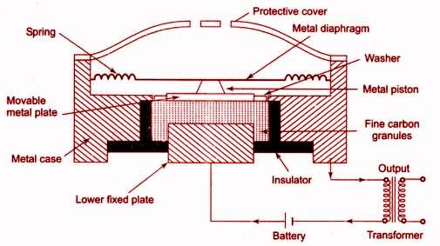
Microphone:
Carbon Microphone:
Construction:Figure shows the construction of a carbon microphone
Consumer Electronics

Slide 19
Operation:
The operating principle is as follows
several hundred carbon granules are held in close contact with each other inside the chamber.
Inside the chamber there are two carbon electrodes.
One of them is fixed and the other one is moving along the diaphragm.
Consumer Electronics

Slide 20
Operation….
When the diaphragm moves to and fro due to the impinging sound wave, the pressure on the carbon granuals varies.
The contact resistance between the surfaces of the carbon granules therefore changes.
This will vary the output current. The output current waveform is similar to the acoustic waveform striking the diaphragm.
As the impedance of the carbon rods is low, a step up transformer is connected to increase the impedance for matching.
This transformer will also help to increase the output voltage and eliminate the DC component from the microphone output.
Consumer Electronics

Slide 21
Precautions:
While handling this microphone following precautions should be taken
The current through the carbon electodes should not exceed that recommended by the manufacturer or the carbon granules may be fused
This microphones should not be subjected to heavy jolts when the current is flowing unless they are designed for such service.
The carbon granules should be sealed off from the humidity.
Consumer Electronics

Slide 22
Characteristics:
Good sensitivity
Flat frequency response from 50 Hz to 5 kHz. 3.Directtivity pattern is substantially Omni directional
4.Poor signal to noise ratio
5.High distortion
Consumer Electronics

Slide 23
Advantages:
Carbon microphones are rugged, less expensive and have high sensitivity
Consumer Electronics

Slide 24
Demerits
Continuous high frequency hiss caused by the changing contact resistance between the carbon granules
Flat frequency response is obtained over limited range 3.Distortion is rather high
4.lt is prone to heat and moisture
Applications
Due to these reasons the carbon microphones are not used for sound reinforcement recording or in any application requiring quality or wide frequency respons.
They are used in the telephone handsets and portable radio communication sets.
Consumer Electronics

Slide 25
Loudspeakers
Definition
Loudspeaker is an electro acoustic transducer which converts the electrical signal at audio frequencies into sound waves.
Frequency of the sound waves will be same as that of the electrical signal and the intensity of sound will be proportional to the magnitude of the electrical signal.
Consumer Electronics

Slide 26
Characteristics of loudspeakers.
The loudspeaker performance can be judged by using the characteristics of loudspeaker.
The performance of different types of loudspeakers can be compared using these characteristics.
Some of the important characteristics are follows:
Directivity
Signal to noise ratio
Efficiency
Frequency response
Distortion
Speaker coil impedance
Power handling capacity
Consumer Electronics

Slide 27
Directivity: All the loudspeakers are not Omni directional. The practical loudspeakers are directional.
Directivity is the ratio of the sound intensity, due to the practical speaker at a point in the direction of maximum intensity to the sound intensity at the same point due to an omni directional loudspeaker.
Input power to both the speakers is same
Signal to noise ratio: This indicates the noise contributed by the loudspeaker.
It is defined as the ratio of signal output to the output noise of speaker in the absence of signal. The signal to noise ratio must be as high as possible.
Consumer Electronics

Slide 28
Efficiency : The speaker efficiency is defined as the ratio of the sound output power of the speaker to the electrical power applied at its input.
The efficiency is measured at a standard frequency of 400 Hertz.
The efficiency can be improved if the mechanical impedance in matched properly with the acoustic impedance of the air volume being disturbed.
Frequency response: It is the plot of loudspeaker output for different frequency signals applied at its input.
Ideally the speaker output should be same irrespective of the frequency i.e. the frequency response should be flat over the entire audio frequency range of 20 Hz to 20 kHz.
Consumer Electronics

Slide 29
Distortion: the non uniform magnetic field in which the speaker coil moves is responsible for producing a non linear distortion.
The frequency and phase distortions may take place as a result of the mass and compliance effect.
Speaker coil impedance: the input impedance of the loudspeaker should be matched with the output impedance of the driving amplifier, to ensure maximum power transfer. It is expressed in ohms, as it is the ac resistance of the speaker. The typical values of speaker impedance are 2,4,8 and 16 ohms.
Consumer Electronics

Slide 30
Power handling capacity:
The maximum power handling capacity is expressed in watts. The power applied to the speaker should never be greater than the maximum power handling capacity, to avoid the speaker damage.
Consumer Electronics

Slide 31
Types of loudspeakers:
The loudspeakers can be classified into three types according to their constructions. They are
1.Moving coil or cone type loud speaker 2.Electrodynamic type loudspeaker 3.Horn type speakers
Consumer Electronics

Slide 32
Moving coil or cone type loud speaker
Principal of operation:
The principle of operation of this speaker is same as that of an electric motor.
A voice coil is placed in a uniform magnetic field produced by permanent magnet.
When audio current passes through the voice coil, an interaction takes place between the magnetic field and the voice coil. This interaction produces a force that works on the voice coil.
Due to this force the voice coil vibrates which makes the conical paper diaphragm to vibrate. This produces sound waves in the surrounding
22/0ª2/^{i}2^{r}0.23
Consumer Electronics Audio system 29

Slide 33
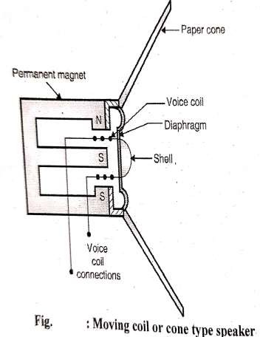
Construction of the cone types speaker
The moving coil loudspeaker consist of a voice coil. It is a single layer winding wound on a cardboard or fibre cylinder. The audio frequency current is applied to this coil through its contacts which are brought out.
A pot type permanent magnet is used to develop strong radial magnetic field. The shape of the magnet is such that it produces strong magnetic flux in the air gap where the voice coil is suspended.
2.2/02/2023
Consumer Electronics Audio system
30

Slide 34
Construction of the cone types speaker…./.
The coil is attached to a conical paper diaphragm. The paper cone is corrugated to have circular corrugations. This increases its surface area.
When the audio frequency current flows through the voice coil the diaphragm vibrates to produce the sound output
Consumer Electronics

Slide 35
Characteristics of cone type loudspeaker:
Directivity: basically this is an Omni directional loudspeaker. But baffles and enclosures can modify the directivity pattern to a unidirectional one.
Signal to noise ratio: it is high normally greater than 30 db.
Efficiency: The eficiency of cone type speaker is very low typically between 5 to 10%
Frequency response: it is flat over a range of about 200Hz to 5kHz. For this reason woofers (massive speakers) for low frequencies and Twitter(small speakers) for the high frequencies are separately designed. they will extend the frequency response from 40 Hz to 10 kHz.
Consumer Electronics

Slide 36
Characteristics of cone type loudspeaker…
High non linear distortion (up to 10%)
Speaker impedance: Varies between 2 to 32 ohms.The commercial speakers have standard values of 4,8 or 16 ohms coil impedance.
Power handling capacity: Ranges between a few milliwatts to a few watts depending on the size of the speaker.
Consumer Electronics

Slide 37
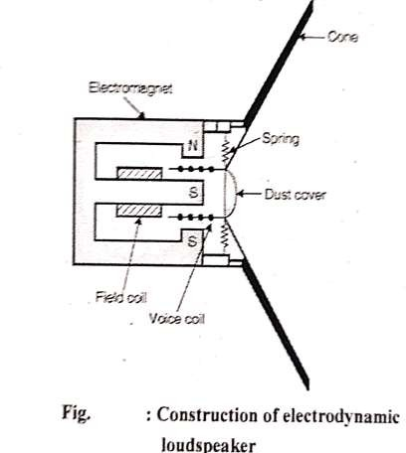
Electrodynamic loudspeaker:
The construction of Electrodynamic loudspeaker is as shown in the figure
The construction is very much similar to that of the cone type loudspeaker
except for one difference. The
been
permanent magnet has replaced by an electromagnet
Consumer Electronics

Slide 38
Construction of Electrodynamic loudspeaker…
This is done in order to increase the strength of the magnetic field for high wattage speakes. (above 25 W). The working principle of this speaker is same as that of the permanent magnet type
Consumer Electronics

Slide 39
Merits and demerits:
The advantages of this loudspeaker are that higher power can be obtained and frequency response is improved.
The disadvantages are that it is a costlier and heavier and needs external supply for the field coil.
Consumer Electronics

Slide 40
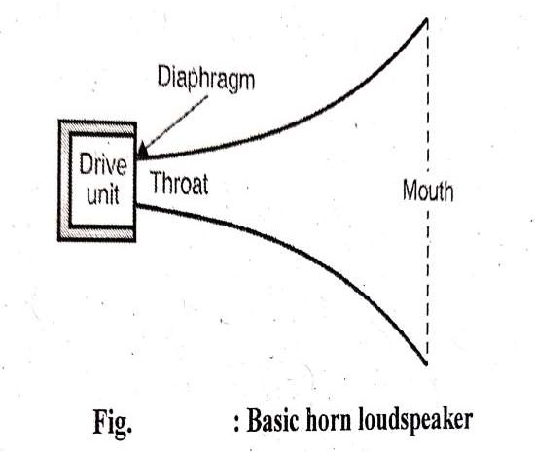
Horn type Loudspeaker
Basic horn loudspeaker:
The construction of the basic horn loudspeaker is as shown in the figure
The drive unit consist of a moving
coil placed in a magnetic similar to a paper cone
field type
speaker, however the paper cone is not present
Consumer Electronics

Slide 41
Instead of radiating the acoustic power directly into the open space, it is first given to an enclosed structure called as exponential horn
Consumer Electronics

Slide 42
Operation
as shown in figure, the horn is a tapered enclosure.
It has two ends called “throat” and “mouth”.
The diameter of the horn increases from the throat to the mouth.
The horn thus forms an air chamber between its two ends.
Horn is lined up with a sound absorbing material.
The operation of the drive unit is identical to that of the paper cone type speaker
Consumer Electronics

Slide 43
Operation….
However here instead of radiating the acoustic power directly into the open space, it is first delivered to the air chamber of the horn.
In this way the horn type speakers are indirect radiating loudspeakers.
The horn thus acts like a coupling device between the diaphragm and the open space. We can say that the horn acts like an acoustic transformer.
Due to the presence of horn acting as acoustic transformer, a better impedance matching between the low impedance of the free air and the high impedance of the voice coil assembly is achieved.
Consumer Electronics

Slide 44
Operation….
Due to this impedance matching, the efficiency of the horn type loudspeaker increases to a value between 30 to 50% .
Remember that the efficiency of the direct radiating loudspeakers is only 5 to 10% .Thus the “horn” improves the efficiency to a great extent.
Consumer Electronics

Slide 45
Frequency response of the horn type speaker:
The cross sectional area of the horn increases logarithmically along its length from the throat to mouth.
Due to this specialized structure, the horn tends to act as a “ high pass filter”. The low frequency reproduction suffers.
The lowest frequency that can be reproduced by a horn is given as fmin = 170/dm
where dm is the diameter of mouth in metres
At the high frequencies, the distance between horn and different points on the diaphragm will not be the same. This will result in phase difference and therefore partial cancellation of the sound waves.
To avoid this, a curved diaphragm as shown in the figure is used.
Consumer Electronics

Slide 46
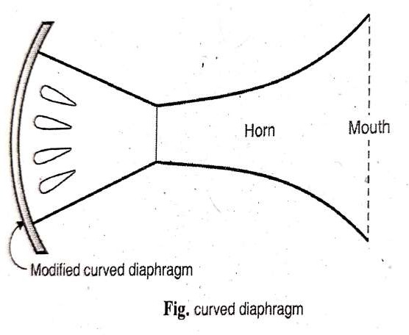
The low frequency response can be improved by having a wide mouth horn structure.
So we need very big horns typically of length 2 m and mouth diameter of 1 m. This huge structure has no practical value.
Consumer Electronics

Slide 47
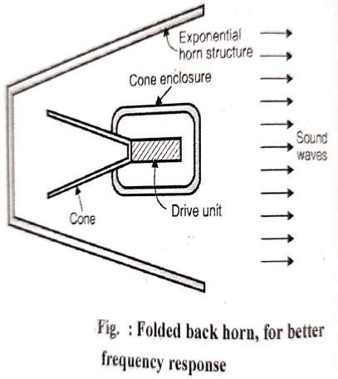
Folded back Horn
Therefore a folded back structure shown in the figure is used.
The horn conserves the physical space due to this structure yet gives improved low and high frequency response.
The improvement in low frequency response is due to the large diameter of mouth whereas the high frequency response is improved due to small throat diameter.
Consumer Electronics

Slide 48
Characteristics of horn type speakers
Efficiency: very good (30-50%)
Signal to noise ratio: Very good (about 40 dB)
Directivity: depends on the frequency range
Frequency response: Good (20 to 10000 Hz.)
Distortion: Low (up to 5%)
Impedance: 16 ohms
Power handling capacity: High (upto 100W)
Consumer Electronics

Slide 49
Electrostatic (condenser/capacitor) Loudspeaker:
Principle:
The principal of operation of electrostatic loudspeaker can be stated as follows:
A DC voltage applied between two parallel metal plates causes them to attract or repel each other.
The amount of attraction or repulsion is dependent on the applied voltage
Consumer Electronics

Slide 50
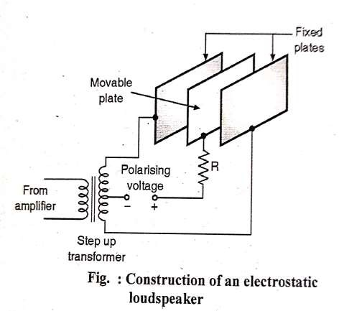
Construction:
Figure shows the construction of the
electrostatic loudspeaker.
It consist of two fixed and one movable metal
plate along with a built-in step up transformer.
The two ends of secondary winding of the step
up transformer are connected to the two fixed
plates whereas the movable plate is connected to
the center tapped secondary via a polarizing voltage.
Resistance R is connected to keep the voltage
stable during variations in the signal voltage.
The polarizing voltage is applied through resistor R to the movable plate as shown
The amplifier output (signal voltage) is applied
to the primary of the step up transformer. It gets
applied to the two fixed plates via the secondary
winding.
Consumer Electronics

Slide 51
Operation
The movable plate acts as the diaphragm. It bends towards or away from the two fixed plates when the signal voltage is applied between the fix plates.
Thus the electrical signal is converted into movement (displacement) of the central plate that is diaphragm.
The polarizing voltage or biasing voltage is applied to the diaphragm to ensure that the frequency of vibration of the diaphragm is same as the signal frequency.
Consumer Electronics

Slide 52
Demerits
It needs to use the DC bias voltage which is much larger (1000 to 1200 volts) than the applied audio signal.
It does not produce enough output at the bass (low) frequencies
It is more useful for producing frequencies above 1000 Hz.
The step up transformer and the polarizing power supply are usually built into the electrostatic speakers which makes them bulky and costly.
Consumer Electronics

Slide 53
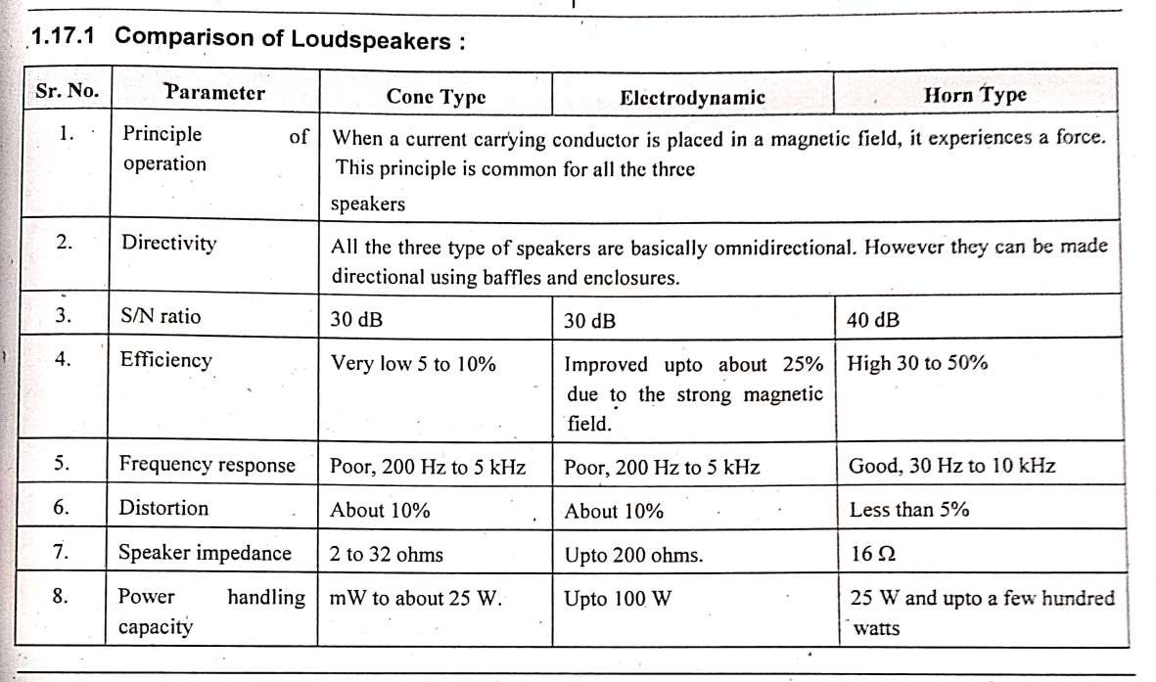
Consumer Electronics

Slide 54
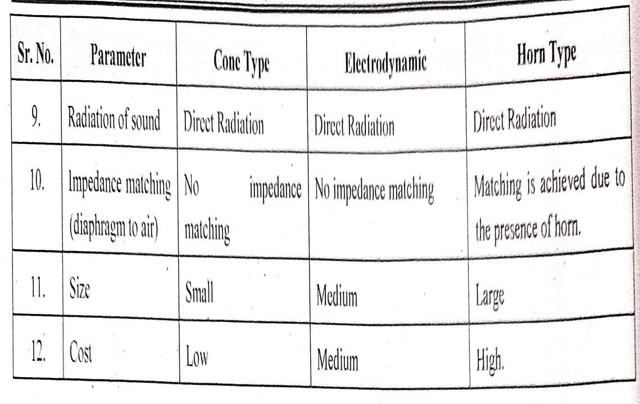
Consumer Electronics

Slide 55
Types of Audio systems depending on Amplifiers used:
Mono Amplifier system
Stereo Amplifier system
Consumer Electronics

Slide 56
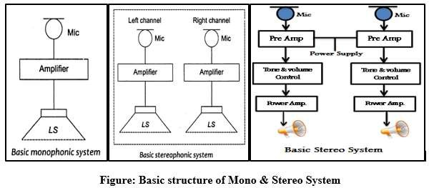
Mono Amplifier system:
In similar way the mono means single. The sound coming from single source, which is processed by single system (having single amplifier).
Consumer Electronics

Slide 57
Audio Systems based on Amplifier……
Fig above shows the basic block diagram of monophonic & stereophonic system which mainly includes
An input source (The Microphone)
A Processing circuit (An amplifier) &
The output source (Loud Speaker)
The monophonic system has a single set of Microphone, Amplifier & Loud Speaker. This means that the sound is captured by the single microphone & it can process through a single amplifier circuit. We can have many Loudspeaker at the output, but the signal given to all Loudspeaker will be same (same in phase).
Consumer Electronics

Slide 58
Components used in Basic Audio systems.
Microphone: Sound is produced when there is a vibration in the atmosphere.
This vibration disturbs the air, causing air particles to bounce off other air particles, carrying the vibration throughout.
We hear these changes in air pressure by translating the change to electrical signals that the brain can process.
A transducer used to convert these sound vibrations into electrical signal is called Microphone.
Consumer Electronics

Slide 59
Amplifier: Most steps of the sound process, such as the microphone and recorder require very little electrical current to be produced. The last step of the process, moving the speaker cone, does require more of a boost in current for the audio signal.
This boost has to preserve the same pattern without any distortion of the original signal. The boost is created by an amplifier.
The amplifier's sole purpose to produce a more powerful audio signal in order to be heard through a speaker.
Although amplifiers have just a simple purpose, the components that make then can be very complex.
Consumer Electronics

Slide 60
Loudspeaker: A loudspeaker (or "speaker", or in the early days of
radio "loud-speaker") is an electroacoustic transducer that
produces sound in response to an electrical audio signal input.
In other words, speakers convert electrical signals into audible signals.
Consumer Electronics

Slide 61
Stereo Amplifier system:
The word ‘stereophony’ is derived from two Greek words: ‘stereos’ & ‘phone’, meaning ‘solid’ & ‘sound’, respectively.
Thus stereophony means solid sound or ‘3-dimensional sound’ .
There is minute difference of phase & intensity in the sounds reaching the 2 ears. This difference is interpreted by the brain such a way so as to enable the listener judge the direction from which the sounds are coming.
Stereophonic sound or, more commonly, stereo, is a method of sound reproduction that creates an illusion of directionality and audible perspective.
Consumer Electronics

Slide 62
Stereo Amplifier system…..
This is usually achieved by using two audio channels through a configuration
or more of two or
independent
more loudspeakers (or stereo headphones)in such a way as to create the impression of sound heard from various directions, as in natural hearing.
Thus the term "stereophonic" applies to so-called "quadraphonic" and "surround-sound" systems as well as the more common two- channel, two-speaker systems.
It is often contrasted with monophonic or "mono" sound, where audio is in the form of one channel.
Consumer Electronics

Slide 63
Difference between Stereophony system & monophony system:
 |  | Mono | Stereo
Stands for |  | Monaural or monophonic sound | Stereophonic sound
Key feature |  | Audio signals are routed through a single channel | Audio signals are routed through 2 or more channels to simulate depth/direction perception, like in the real world.
Recording |  | Easy to record, requires only basic equipment | Requires technical knowledge and skill to record, apart from equipment. It's important to know the relative position of the objects and events.
Cost |  | Less expensive for recording and reproduction | More expensive for recording and reproduction
Circuit C₂₂o_{/0}m_{2/}p₂₀l₂e₃xity |  | Less Complex then Consumer Electronics | More Complex Audio system 60

Slide 64
Usage | Public address system, radio talk shows, hearing aid, telephone and mobile communication, some AM radio stations | Movies, Television, Music players, FM radio stations
Circuit Diagram | Draw circuit diagram of mono amplifier system | Draw circuit diagram stereo amplifier system
Signal to Noise ratio | Less signal to noise ratio | Better than 50 dB is the S/N ratio.
Distortion | Nonlinear distortion occurs. | Nonlinear distortion not more than input/output.
Use of equalizer 13/03/2024 | Equalizers are not used Consumer Electronics Con | Contains equalizer circuit. sumer Electronics Unit-I 61

Slide 65
Public Address System (PA System):
It is an electroacoustic system, in which sound is first converted into electrical signals by a microphone.
The electrical audio signals are amplified, processed & fed to another transducer, the loudspeaker, which converts the audio signals into sound waves.
A block diagram of a basic PA system is shown in fig. below. The function of each block of PA system is described below.
Consumer Electronics

Slide 66
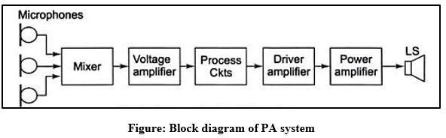
Consumer Electronics

Slide 67
Working of PA System
Microphone: It picks up sound wave & converts them into electrical variations, called audio signals.
Generally, amplifiers have provision of 2 or more microphones & in addition, an auxiliary input for tape/record player.
Mixer: The output of microphones is fed to mixer stage. The function of mixer stage is to effectively isolate different channels from each other before feeding to the main amplifier. It can be either a built-in unit or a separate pluggable unit.
Voltage amplifier: It is an amplifier which further amplifies the output of the mixer.
Consumer Electronics

Slide 68
Processing circuit: These circuits have ‘Master gain control’ & tone controls (Bass/Treble controls).
Driver amplifier: It gives voltage amplification to the signal to such an extent that when fed to the next stage (power amplifier stage), the internal resistance of that stage is reduced. Thus it drives the power amplifier to give more power.
Power amplifier: It gives desired power amplification to the signal. It uses push pull type of circuit in general, so that the even harmonics are eliminated from the output, & the transformer core does not get saturated.
The output of power amplifier is connected to the loudspeaker through matching transformer to match the low impedance of the loudspeaker for maximum transfer of power.
Consumer Electronics

Slide 69
Loudspeaker: A loudspeaker is an electroacoustic transducer that produces sound in response to an electrical audio signal input.
In other words, speakers convert electrical signals into audible signals.
Consumer Electronics

Slide 70
DJ
What is a DJ?
DJ is the short form for disc jockey. Disc jockeys play the music you hear on radio stations, internet radio stations, local bars and dance clubs, and even at wedding receptions.
A disc jockey (also called a DJ or deejay) is a person who plays recorded pop or dance music for dancers or listeners and introduces the names of the songs using a microphone.
A disc jockey will consider their target audience when selecting the music to be played and often has a list of song requests given to them by the person or company that hired them.
Consumer Electronics

Slide 71
What does a DJ do?
A DJ plays pre-recorded music from other musicians, usually drawing from a large collection of available songs that suit the theme of the event or venue he or she is working at.
A disc jockey has several responsibilities depending on their workplace and position in the music industry.
Consumer Electronics

Slide 72
Types of DJs
There are several types of DJs.
A radio DJ plays music files (like mp3) or recorded CDs on a radio station and announces the names of the songs.
A club DJ plays music files or recorded CDs over a PA system (an amplifier and loudspeakers) at a nightclub, rave, or disco.
A hip hop DJ uses turntables and vinyl records to do scratching and make music while other hip hop musicians do rapping (rhythmic type of singing).
A Reggae DJ plays recordings of rhythm instruments and then rap on top of the prerecorded track with a microphone.
An Electronic Dance Music DJ creates their own music and some can even remix their own songs on the fly.
Consumer Electronics

Slide 73
Types of DJs……
Similar to different types of musicians in other genres like people who play baroque music Vs people who play Jazz or People who like Death Metal vs People who like Screamo, depending on the genre; some DJs tend to act quite differently,
for example, Dubstep DJs are more rowdy and prefer faster more zappy treble,
House producers are the opposite and prefer slower and more natural melodys and then you also have
Psytrance DJs who prefer more techno driven white noise delivered in high beats per minute with whale songs and sound effects.
Consumer Electronics

Slide 74
In a radio station, a disc jockey is responsible for playing tracks from a set playlist that is given to them by station management.
This playlist will often target a specific audience and music genre.
Also, a radio station disc jockey is responsible for answering calls from listeners. These calls may be the result of an artist interview, station contest, or even just to comment on the selections being played.
The disc jockey is in charge of interviews conducted with musicians of the genre chosen by the radio station, as well as being responsible for announcing commercials in accordance with the stations set programming requirements.
Consumer Electronics

Slide 75
DJ Mixer
A DJ mixer is a type of audio mixing console used by disc jockeys (DJs) to control and manipulate multiple audio signals.
Some DJs use the mixer to make seamless transitions from one song to another when they are playing records at a dance club.
Consumer Electronics

Slide 76
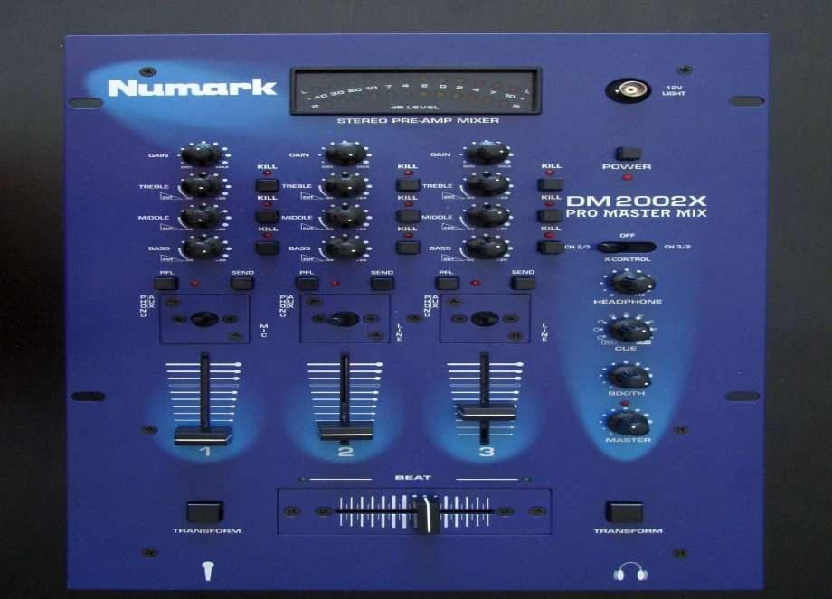
Consumer Electronics

Slide 77
Hip hop DJs and turntablists use the DJ mixer to play record players like a musical instrument and create new sounds.
DJs in the disco, house music, electronic dance music and other dance-oriented genres use the mixer to make smooth transitions between different sound recordings as they are playing.
The sources are typically record turntables, compact cassettes, CDJs, or DJ software on a laptop.
DJ mixers allow the DJ to use headphones to preview the next song before playing it to the audience.
Most low- to mid-priced DJ mixers can only accommodate two turntables or CD players, but some mixers (such as the ones used in larger nightclubs) can accommodate up to four turntables or CD players.
DJs and turntablists in hip hop music and nu metal use DJ mixers to create beats, loops and so-called scratching sound effects.
Consumer Electronics
77

Slide 78
Description
DJ mixers are usually much smaller than other mixing consoles used in sound reinforcement systems and sound recording.
Whereas a typical nightclub mixer will have 24 inputs
A professional recording studio's huge mixer may have 48, 72 or even 96 inputs,
A typical DJ mixer may have only two to four inputs.
The key feature that differentiates a DJ mixer from other types of larger audio mixers is the ability to redirect (cue) the sounds of a non- playing source to headphones, so the DJ can find the desired part of a song or track.
Consumer Electronics
78

Slide 79
Outputs of DJ Mixer
The output from a DJ mixer is typically plugged into a sound reinforcement system or a PA system at a dance, rave, nightclub or similar venue or event.
The sound reinforcement system consists of power amplifiers which amplify the signal to the level that can drive speaker enclosures, which since the 1980s typically include both full-range speakers and subwoofers for the deep bass sounds.
If the DJ is performing a mix for a radio station or television station, the output from the DJ mixer is plugged into the main audio console being used for the broadcast. If the DJ is performing a mix that is being recorded by a recording studio, the output from the DJ mixer is plugged into the main audio console used for the recording, which is in turn plugged into the recording medium (audiotape, hard disk, etc.).
Consumer Electronics
79

Slide 80
In some cases, such as when a DJ is performing a set at a club for dancers that is also being simultaneously broadcast over the radio or television system or recorded for a music video or other show, the output from the DJ mixer is plugged into the sound reinforcement system and into the main audio console being used for the broadcast and/or recording.
At club sets, some DJs may use a monitor speaker to hear the house's main mix. This monitor speaker can have its volume increased or decreased by the DJ as needed.
Consumer Electronics
80

Slide 81
Power
DJ mixers have an AC mains plug that is connected to the wall to supply electric power for the unit.
Some DJ mixers can take batteries, which enables users to mix songs outside or away from electric power sources, with the output being plugged into a portable boom box or other battery-powered sound system.
Consumer Electronics
81

Slide 82
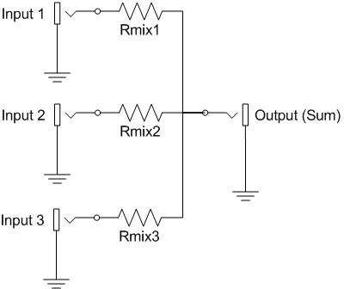
Electronic Mixers
Consumer Electronics
82

Slide 83
Electronic Mixers….
An electronic mixer is a device that combines two or more electrical or electronic signals into one or two composite output signals.
There are two basic circuits that both use the term mixer, but they are very different types of circuits: additive mixers and multiplicative mixers.
Additive mixers are also known as analog adders to distinguish from the related digital adder circuits.
Simple additive mixers use Kirchhoff's circuit laws to add the currents of two or more signals together, and this terminology ("mixer") is only used in the realm of audio electronics where audio mixers are used to add together audio signals such as voice signals, music signals, and sound effects.
Consumer Electronics
83

Slide 84
Electronic Mixers….
Multiplicative mixers multiply together two time-varying input signals instantaneously (instant-by-instant).
If the two input signals are both sinusoids of
specified frequencies f₁ and f₂, then the output of the mixer will contain two new sinusoids that have the sum f₁ + f₂ frequency and the difference frequency absolute value |f₁ - f₂|.
Consumer Electronics
84

Slide 85
An analog audio
An Analog Audio:
Audio is sound. Sound itself is an analog signal. Thus an analog audio is an electrical signal that is in the wave format and which exactly represents the original sound signal.
The analog audio is recorded on a magnetic tape or gramophone disc.
The analog audio is susceptible to noise and distortions. The quality of analog audio is not very good
The quality degrades every time we make a copy of the analog audio.
Due to all these problems, the analog audio is not being used in the modern days.
Instead every where the digital audio is being used.
Consumer Electronics
85

Slide 86
Digital Audio:
Definition:
Digital audio is audio or simply sound signal that has been recorded as or converted into digital form
Digital audio generation:
Digital audio is recorded by taking samples of the original sound wave at a specific rate.
Each sampled value is then encoded into a group of binary bits to convert it into a digital form. An encoder is basically an Analog to Digital Converter (ADC)
This digital audio is then applied to an audio compressor which compresses it to reduce its Bit Rate (BR) without reducing its quality significantly
Consumer Electronics
86

Slide 87
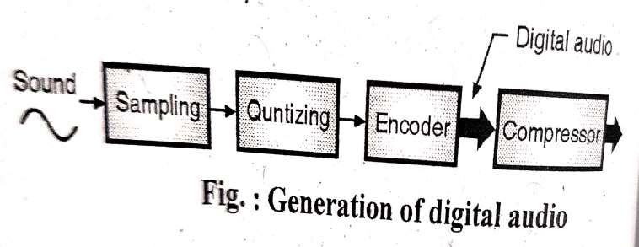
Fig below shows the basic concept of digital audio generation.
Consumer Electronics
87

Slide 88
Digital Audio…
For recording the digital audio contents on a CD. The sampling rate is 44.1k samples/sec, and each sample encoded to a 16 bit digital word.
Digital audio is actually the name given to the entire technology used for recording and reproduction using audio signals that have been encoded into the digital form.
In a digital audio system, sound in the analog electric form is converted into a digital signal using an Analog to Digital Converter(ADC). The Pulse Code Modulation (PCM) technique is used for such conversion.
Consumer Electronics
88

Slide 89
The digital audio signal produced with this technique can be recorded, edited, modified and stored on computers or any digital storage device such as a CD or pen drive or a hard disc.
Consumer Electronics
89

Slide 90
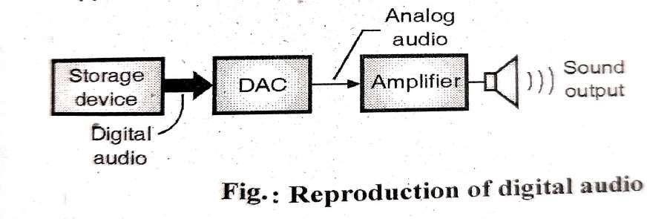
Reproduction:
The analog electric audio signal is amplified and applied to the loud speaker as shown.
Consumer Electronics
90

Slide 91
In order to listen to the digital audio contents on a loud speaker or headphone, we need to first convert it to an analog electric sound signal with the help of a Digital to Analog Converter (DAC) as shown in Fig. last slide.
Consumer Electronics
91

Slide 92
Advantages of Digital Audio :
A digital audio can be processed easily.
It can be compressed by using a suitable compression technique which reduces its storage space and transmission bandwidth.
There is no loss of signal quality even if an infinite number of copies of a digital audio are made.
4.- Digital audio is less susceptible to errors, distortion and noise.
5. An optional error correction technique is called channelcoding
Consumer Electronics
92

Slide 93
Conversion Process :
Digital audio is used in recording, manipulation, mass- production and distribution of sound that includes recorded songs, podcasts, sound effects etc.
The modern on line music distribution is based on the digital recording and data compression.
With music distribution on, the Internet, it is not necessary to distribute music using CDs or tapes.
Consumer Electronics
93

Slide 94
Digital audio signal is obtained by sampling the analog audio at 44.1 kHz and then encoding it using a DAC in a digital signal at a known bit resolution.
A CD audio has a bit resolution of 16-bits for each stereo channel.
A digital audio signal maybe either stored or transmitted
A digital audio can be stored on a CD, hard disc or any other digital storage devices.
A digital audio signal may be altered using digital signal processing for upsampling, downsampling, filtering etc
Consumer Electronics
94

Slide 95
Audio Data Compression
Need of audio compression
When audio is convered into a digital audio signal,it needs a large bandwidth for transmission and a large space for its storage on a CD.
Audio data compression can reduce the bandwidth requirement as well as the storage space.
Therefore some kind of compression technique is used in the digital audio transmission (on the internet) or its storage on a CD.
Consumer Electronics
95

Slide 96
Types of compression techniques:
Compression techniques are of two types
Lossless compression
Lossy Compression
In the lossless compression there is absolutely no loss of data. But in the lossy compression there is a loss of information in a controlled manner
Consumer Electronics
96

Slide 97
The commonly employed audio data compressive techniques are as follows
MP3 (MPEG-1 Audio Layer-3)
Advanced audio coding
FLAC(Free Lossless Audio Codec)
These techniques are used to reduce the file size required to store the digital audio
MP3 is a lossy type of audio compression technique
Consumer Electronics
97

Slide 98
A quality audio on CD requires a transmission bandwidth of 1.411 Mbps. So a substantial compression is necessary to make transmission over the Internet possible.
Hence various audio compression algorithms are developed
The most popular algorithm is MPEG audio. It has three layers (variants) Out of these layers MP3 (MPEG layer 3) is the most powerful and best known.
MPEG is actually a video compression standard and MP3 belongs to its audio portion
One way of audio compression is to use the waveform coding technique.
The other type is perceptual coding. MP3 is based on perceptual coding
Consumer Electronics
98

Slide 99
The perceptual coding is based on frequency masking principal
the audio compression is done by sampling the waveform at 32 kHz,
44.1 kHz or 48 kHz.
Sampling can be done on one or more channels in anyone of the following four configurations
Monophonic (a single input stream)
Dual monophonic (for example an English and French sound tracks)
Disjoint stereo (each channel compressed separately)
joint stereo
Consumer Electronics
99

Slide 100
First the output bit rate is chosen. Standard bit rates are 96 Kbps,128 Kbps etc
Then the samples are passed in groups of 1152
Each group of samples is first passed through 32 digital filters to get 32 frequency bands
At the same time the input is fed into psycho acoustic mode in order to determine the masked a frequencies
Then each of the 32 frequency bands is further transformed to provide the finer spectral resolution.
The bits are encoded using Huffman encoding. Various techniques are used for noise reduction, antializing and for exploiting the interchannel redundancy.
Consumer Electronics
100

Slide 101
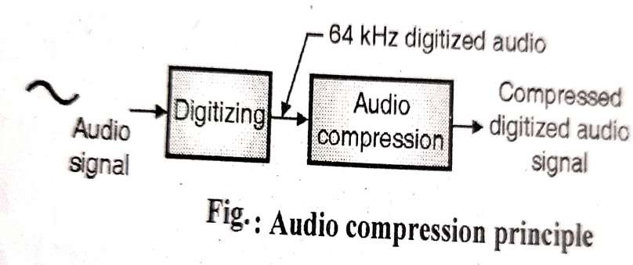
Block Diagram
The audio compression is used to send speech on music
For speech we have to compress the 64 kHz digitized signal. This concept is illustrated as shown in the figure
Consumer Electronics
101

Slide 102
For the speech we have to compress the 1.411 MHz digitized music signal. For audio compression, we need to use either predictive encoding or perceptual encoding
•
Consumer Electronics
102

Slide 103
Predictive encoding
In this technique, first the audio signal is sampled. Then the differences between the samples are encoded instead of encoding all the samples.
This type of encoding is generally preferred for the speech signals
A Quality audio on CD requires a transmission bandwidth of 1.411 Mbps. So a substantial compression is necessary to make transmission over the internet possible
Hence various audio compression algorithms are developed.
The most popular algorithm is MPEG audio. It has three layers (variants). Out of these layers MP3 (MPEG layer 3) is the most powerful and best known.
MPEG is actually a video compression standard and MP3 belongs to its audio portion.
One way of audio compression is to use the waveform coding technique
The other type is perceptual coding.
Consumer Electronics
103

Slide 104
A Home theatre
A home theatre, is an integrated audio, video system which consists of a DVD or a Blu ray player, a multichannel amplifier, a set of five or more surround sound speakers, speaker wires, connection cables, a remote control and a subwoofer cabinet.
Some of the manufacturers of home theatres are Philips, Sony, Panasonic, LG, Samsung etc
The low price Home theatre systems are called as the "2.1" systems, whereas the higher quality ones are called as "5.1" or "7.1" systems.
Consumer Electronics
104

Slide 105
What the terms 2.1, 5.1, and 7.1 Mean?
The 2, 5, and 7 represent the number of channels where the speakers are laid out in a horizontal plane preferably placed at approximately ear level, while the .1 represents the subwoofer which is placed on the floor.
Thus a 5.1 system has 5 speakers including a front, left and right and a front center speaker. It also includes rear left and right speakers plus a subwoofer for a surround sound experience. A 2.1 system is just the Left and Right channel in the front and a subwoofer.
Consumer Electronics
105

Slide 106
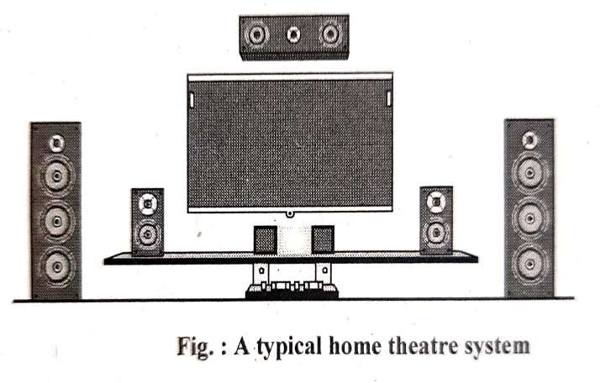
A Home theatre ….
A Typical home theatre system is shown in the figure
Consumer Electronics
106

Slide 107
A Home theatre ….
Features
The important features of a high end home theatre system are as follows
Surround sound speakers
It does not include a TV or a monitor
Wireless speakers
1080i or 4K video resolution (HD quality video)
Consumer Electronics
107

Slide 108
5 disc platter (the spinning surface that the record is placed on)
HDMI (High-Definition Multimedia Interface) inputs
USB (Universal Serial Bus) connectivity
Bluetooth support
Wi-Fi support
Provision of hard disc for recording the TV shows Advantages
Home theatre is an all in one way to enjoy the surround sound experience of home cinema The customer doesn't have to select different units such as amplifiers, speakers, cables etc on his own.
Drawbacks:
The home theatres lack the features and tweakabillity of home theatre components which are available separately in market
These systems are quite expensive.
Consumer Electronics
108

